Slide 1


EXTENDED KALMAN FILTER
A Kalman filter is an iterative algorithm which uses a system's physical laws of motion, known control inputs and multiple sequential measurements to form an estimate of the system's varying quantities
At each step of the iteration an estimate of the state of the system is produced as a weighted average of the system's predicted state and of the new measurement. The weights are calculated from the covariance.
The extended Kalman filter expands the Kalman filter technique to non-linear systems
The models for state transition and measurement can be written as:
$$x_{k}=f\left(x_{k−1},u_{k−1}\right)+w_{k−1}$$
$$z_{k}=h\left(x_{k} \right)+v_{k}$$
Where $f$ is the function of the previous state, $x_{k−1}$ , and the control input, $u_{k−1}$, that provides the current state $x_{k}$. $h$ is the measurement function that relates the current state, $x_{k}$, to the measurement $z_{k}$. $w_{k−1}$and $v_{k}$ are Gaussian noises for the process model and the measurement model with covariance 𝑄 and 𝑅, respectively

Slide 2




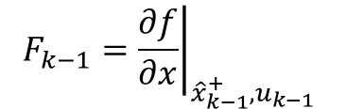
EXTENDED KALMAN FILTER ALGORITHM
Make a priori predictions for the current step’s state and covariance matrix using the a posteriori best estimate of the previous step (i.e. updated using measurement)
STATE VECTOR
$${\hat{x}}_{k}^{−}=f\left({\hat{x}}_{k−1}^{+},u_{k−1}\right)$$
COVARIANCE MATRIX
$$P_{k}^{−}=F_{k−1}P_{k−1}^{+}F_{k−1}^{T}+Q$$
$$F_{k−1}={\left.\frac{∂f}{∂x}\right|}_{{\hat{x}}_{k−1}^{+},u_{k−1}}$$
$$H_{k}={\left.\frac{∂h}{∂x}\right|}_{{\hat{x}}_{k}^{−} }$$
$$Q$$
JACOBIAN
CONVERSION MATRIX
PROCESS NOISE COVARIANCE
Note: In the first iteration step we use step 0 estimates for the state vector and the covariance matrix ($x_{0},P_{0}$), which can be made very roughly

Slide 3





EXTENDED KALMAN FILTER ALGORITHM
Calculate the measurement residual and the Kalman Gain
RESIDUAL
$${\tilde{y}}_{k}=z_{k}−h({\hat{x}}_{k}^{−})$$
$$R$$
KALMAN GAIN
$$K_{k}=P_{k}^{−}H_{k}^{T}{\left(R+H_{k}P_{k}^{−}H_{k}^{T}\right)}^{−1}$$
MEASUREMENT NOISE COVARIANCE
Update the estimate
STATE VECTOR
$${\hat{x}}_{k}^{+}={\hat{x}}_{k}^{−}+K_{k}\tilde{y}$$
COVARIANCE MATRIX
$$P_{k}^{+}=\left(1−K_{k}H_{k}\right)P_{k}^{−}$$

Slide 4
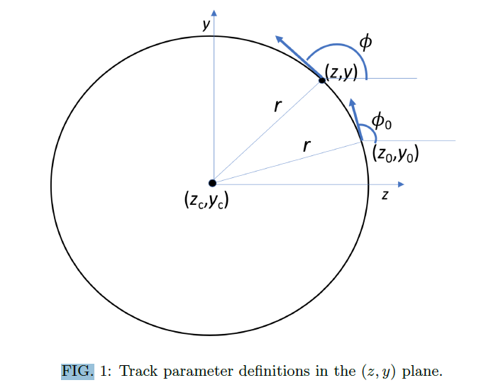
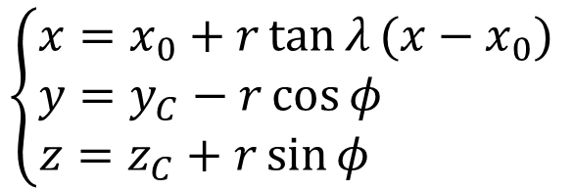
KALMAN FILTER APPLICATION
We want to apply the extended Kalman filter to the motion of a charged particle in the magnetic field
$$\left\{\begin{aligned}x=x_{0}+r\tan{λ}(x−x_{0}) \\ &y=y_{C}−r\cos{φ} \\ z=z_{C}+r\sin{φ} \end{aligned}\right.$$
EQUATIONS OF MOTION
We apply the Kalman filter to track candidates, consisting of groups of TPC clusters, which are identified and put together during the reconstruction process. Each step of the Kalman filter algorithm is identified by one of these TPC clusters

Slide 5
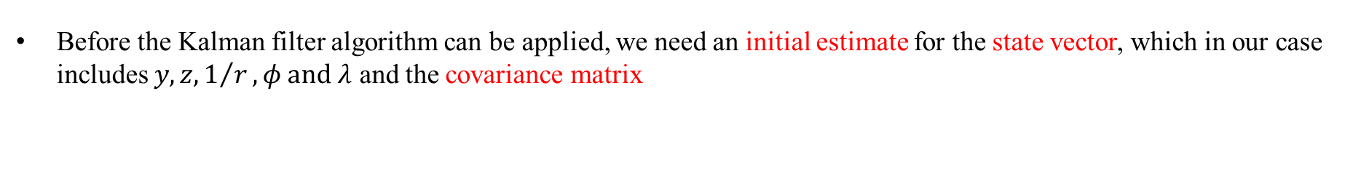

KALMAN FILTER APPLICATION: initial estimates
Before the Kalman filter algorithm can be applied, we need an initial estimate for the state vector, which in our case includes $y,z,1/r,φ and λ$ and the covariance matrix
STATE VECTOR
$$x_{0}^{T}=\begin{matrix}(y_{0} & z_{0} & 1/r_{0}\end{matrix} \begin{matrix}φ_{0} & λ_{0}\end{matrix})=\left(\begin{matrix}0 & 0 & 0.1\end{matrix} \begin{matrix}0 & 0\end{matrix}\right)$$
$$P_{0}=\left(\begin{matrix}1^{2} & 0 & 0 \\ 0 & 1^{2} & 0 \\ \begin{aligned}0 \\ 0 \\ 0\end{aligned} & \begin{aligned}0 \\ 0 \\ 0\end{aligned} & \begin{aligned}{0.5}^{2} \\ 0 \\ 0\end{aligned}\end{matrix} \begin{matrix}0 \\ 0 \\ \begin{aligned}0 \\ {0.5}^{2} \\ 0\end{aligned}\end{matrix} \begin{matrix}0 \\ 0 \\ \begin{aligned}0 \\ 0 \\ {0.5}^{2}\end{aligned}\end{matrix}\right)$$
COVARIANCE MATRIX

Slide 6
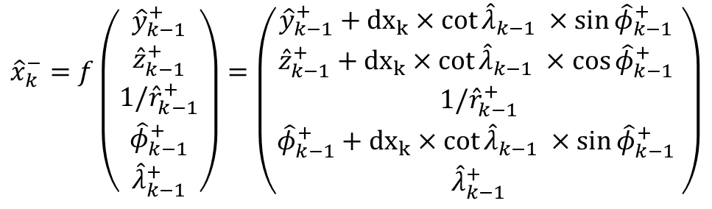
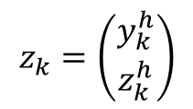
KALMAN FILTER APPLICATION: prediction AND MEASUREMENT
From the equation of motion we obtain the prediction function for our state vector.
$${\hat{x}}_{k}^{−}=f\left({{\hat{y}}_{k−1}^{+} \atop \begin{aligned}{\hat{z}}_{k−1}^{+} \\ {1/\hat{r}}_{k−1}^{+} \\ {\hat{φ}}_{k−1}^{+} \\ {\hat{λ}}_{k−1}^{+}\end{aligned}}\right)=\left({{\hat{y}}_{k−1}^{+}+{dx}_{k}×cot{{\hat{λ}}_{k−1} ×\sin{{\hat{φ}}_{k−1}^{+} }} \atop \begin{aligned}{\hat{z}}_{k−1}^{+}+{dx}_{k}×cot{{\hat{λ}}_{k−1} ×\cos{{\hat{φ}}_{k−1}^{+} }} \\ {1/\hat{r}}_{k−1}^{+} \\ {\hat{φ}}_{k−1}^{+}+{dx}_{k}×cot{{\hat{λ}}_{k−1} ×\sin{{\hat{φ}}_{k−1}^{+} }} \\ {\hat{λ}}_{k−1}^{+}\end{aligned}}\right)$$
The only measured quantities in our case are $y$ and $z$, and are set at the center of the TPC cluster correspondent to the present step.
$$z_{k}=\left({y_{k}^{h} \atop z_{k}^{h}}\right)$$

Slide 7
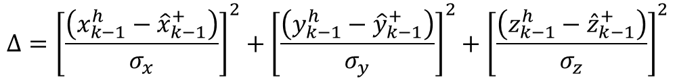
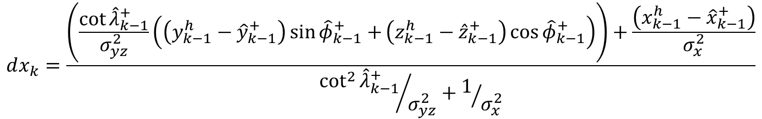
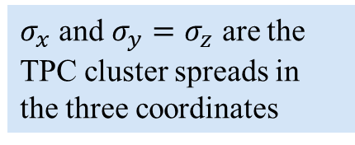
KALMAN FILTER APPLICATION: STEP DEtermination
Each algorithm step corresponds to a TPC cluster. The x coordinate is treated as independent and used to identify the step width $dx$. The step width is determined for each algorithm step, so that it minimizes:
$$Δ={\left[\frac{\left(x_{k−1}^{h}−{\hat{x}}_{k−1}^{+}\right)}{σ_{x}}\right]}^{2}+{\left[\frac{\left(y_{k−1}^{h}−{\hat{y}}_{k−1}^{+}\right)}{σ_{y}}\right]}^{2}+{\left[\frac{\left(z_{k−1}^{h}−{\hat{z}}_{k−1}^{+}\right)}{σ_{z}}\right]}^{2}$$
$σ_{x}$ and $σ_{y}=σ_{z}$ are the TPC cluster spreads in the three coordinates
For each step we then have:
$$dx_{k}=\frac{\left(\frac{\cot{{\hat{λ}}_{k−1}^{+}}}{σ_{yz}^{2}}\left(\left(y_{k−1}^{h}−{\hat{y}}_{k−1}^{+}\right)\sin{{\hat{φ}}_{k−1}^{+}+}\left(z_{k−1}^{h}−{\hat{z}}_{k−1}^{+}\right)\cos{{\hat{φ}}_{k−1}^{+}}\right)\right)+\frac{\left(x_{k−1}^{h}−{\hat{x}}_{k−1}^{+}\right)}{σ_{x}^{2}}}{{\cot^{2}{{\hat{λ}}_{k−1}^{+}}}/{σ_{yz}^{2}}+1/{σ_{x}^{2}}}$$

Slide 8
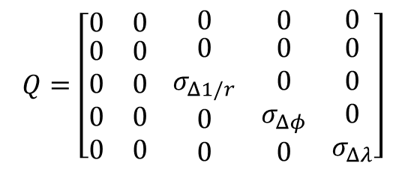
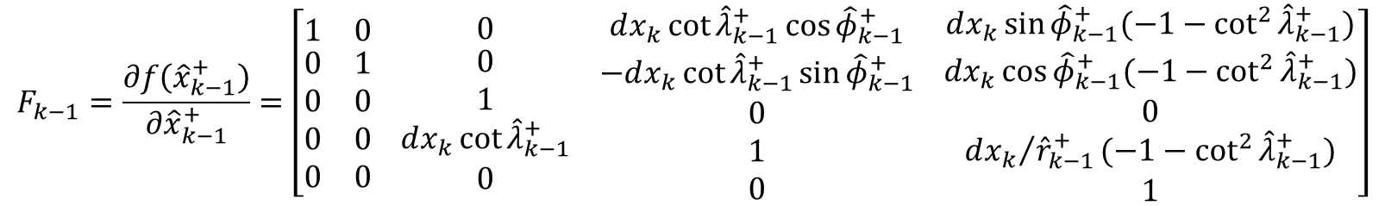

KALMAN FILTER APPLICATION: COVARIANCE MATRIX PREDICTION
First step to make the prediction for the covariance matrix is to calculate the Jacobian
$$F_{k−1}=\frac{∂f\left({\hat{x}}_{k−1}^{+}\right)}{∂{\hat{x}}_{k−1}^{+}}=\left[\begin{matrix}1 & 0 \\ \begin{aligned}0 \\ 0 \\ 0 \\ 0\end{aligned} & \begin{aligned}1 \\ 0 \\ 0 \\ 0\end{aligned}\end{matrix} \begin{matrix}0 \\ \begin{aligned}0 \\ 1 \\ dx_{k}\cot{{\hat{λ}}_{k−1}^{+}} \\ 0\end{aligned}\end{matrix} \begin{matrix}dx_{k}\cot{{\hat{λ}}_{k−1}^{+}\cos{{\hat{φ}}_{k−1}^{+}}} \\ \begin{aligned}−dx_{k}\cot{{\hat{λ}}_{k−1}^{+}\sin{{\hat{φ}}_{k−1}^{+}}} \\ 0 \\ 1 \\ 0\end{aligned}\end{matrix} \begin{matrix}dx_{k}\sin{{\hat{φ}}_{k−1}^{+}(−1−\cot^{2}{{\hat{λ}}_{k−1}^{+}})} \\ \begin{aligned}dx_{k}\cos{{\hat{φ}}_{k−1}^{+}(−1−\cot^{2}{{\hat{λ}}_{k−1}^{+}})} \\ 0 \\ {dx_{k}}/{{\hat{r}}_{k−1}^{+}}(−1−\cot^{2}{{\hat{λ}}_{k−1}^{+}}) \\ 1\end{aligned}\end{matrix}\right]$$
The step uncertainty matrix is also needed
$$Q=\left[\begin{matrix}0 & 0 \\ \begin{aligned}0 \\ 0 \\ 0 \\ 0\end{aligned} & \begin{aligned}0 \\ 0 \\ 0 \\ 0\end{aligned}\end{matrix} \begin{matrix}0 \\ \begin{aligned}0 \\ σ_{Δ1/r} \\ 0 \\ 0\end{aligned}\end{matrix} \begin{matrix}0 \\ \begin{aligned}0 \\ 0 \\ σ_{Δφ} \\ 0\end{aligned}\end{matrix} \begin{matrix}0 \\ \begin{aligned}0 \\ 0 \\ 0 \\ σ_{Δλ}\end{aligned}\end{matrix}\right]$$
The prediction is then:
$$P_{k}^{−}=F_{k−1}P_{k−1}F_{k−1}^{T}+Q$$

Slide 9

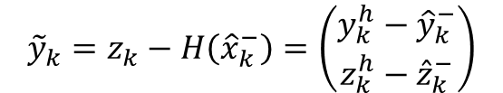


KALMAN FILTER APPLICATION: Evaluate the residual
We now evaluate the residual and Kalman Gain
RESIDUAL
With:
$${\tilde{y}}_{k}=z_{k}−H\left({\hat{x}}_{k}^{−}\right)=\left(\begin{matrix}y_{k}^{h}−{\hat{y}}_{k}^{−} \\ z_{k}^{h}−{\hat{z}}_{k}^{−}\end{matrix}\right)$$
$$R=\left(\begin{matrix}σ_{yz}^{2} & 0 \\ 0 & σ_{yz}^{2}\end{matrix}\right)$$
PROCESS ERROR MATRIX
KALMAN GAIN
$$H=\left(\begin{matrix}1 & 0 & 0 \\ 0 & 1 & 0\end{matrix} \begin{matrix}0 \\ 0\end{matrix} \begin{matrix}0 \\ 0\end{matrix}\right)$$
$$K_{k}=P_{k}^{−}H{\left(R+HP_{k}^{−}H^{T}\right)}^{−1}$$
CONVERSION MATRIX

Slide 10
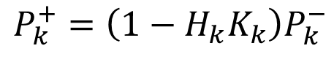

KALMAN FILTER APPLICATION: PREDICTION UPDATE
We are now finally able to update our estimates using both the a priori prediction and the measurement
STATE VECTOR
$${\hat{x}}_{k}^{+}={\hat{x}}_{k}^{−}+K_{k}{\tilde{y}}_{k}$$
COVARIANCE MATRIX
$$P_{k}^{+}=\left(1−H_{k}K_{k}\right)P_{k}^{−}$$

Slide 11

KALMAN FILTER APPLICATION:$Χ^{2}$
The Kalman filter algorithm is applied to the track candidate both ways (i.e. From first TPC cluster to last and vice versa) and each time a $χ^{2}$ value is calculated
$$χ^{2}=\frac{\sum{{\left|{\tilde{y}}_{k}\right|}^{2}}}{\sum{{\left|y_{k}^{typ}\right|}^{2}}}$$
Where $y_{k}^{typ}$ is the residual typical value evaluated using the MC truth informations for the particle trajectory (still need to understand exactly how it is evaluated)

Slide 12
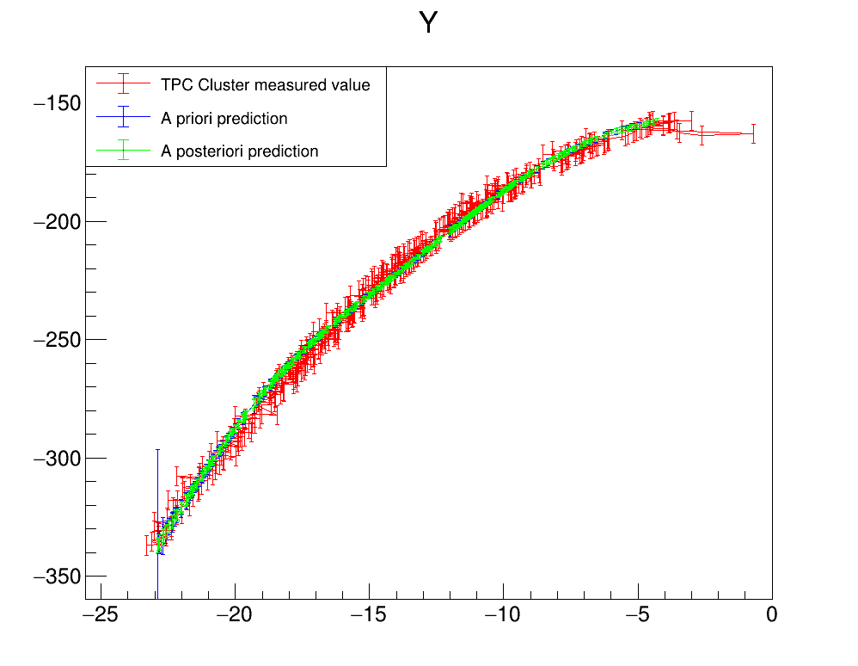
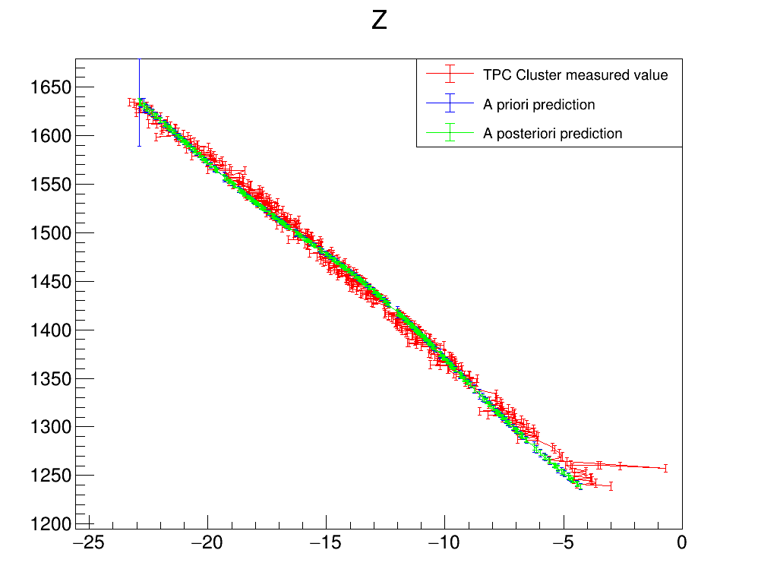
KALMAN FILTER PERFORMANCE
Plots describing the evolution of the estimate of the measured quantities $(y,z)$ as a function of the free parameter $x$ (Information retrieved directly modifying the kalman filter module in garsoft tpctrackfit2_module.cc) for a muon from a particle gun pointing towards the center of the TPC

Slide 13
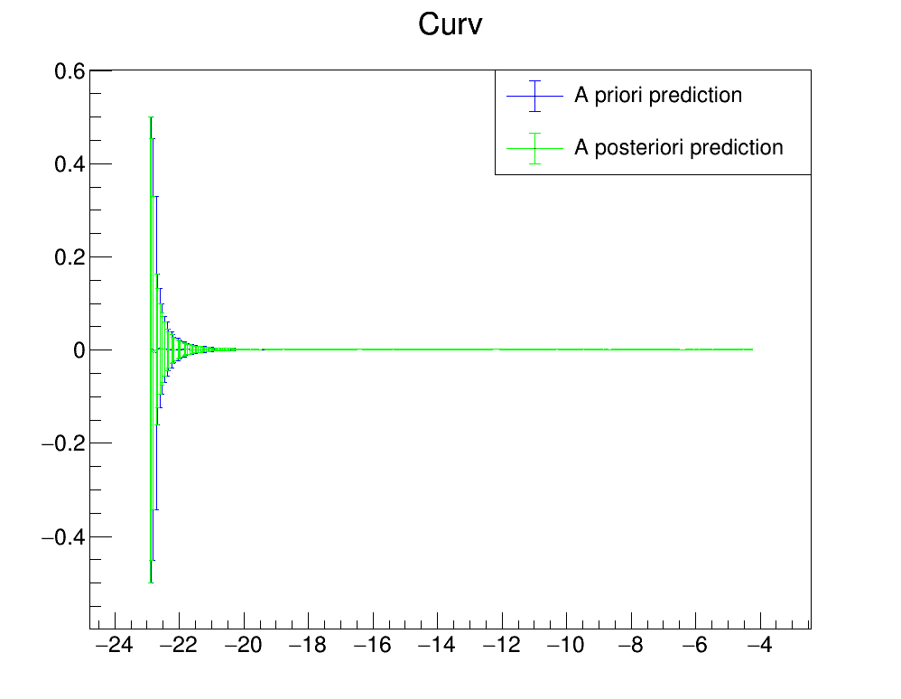
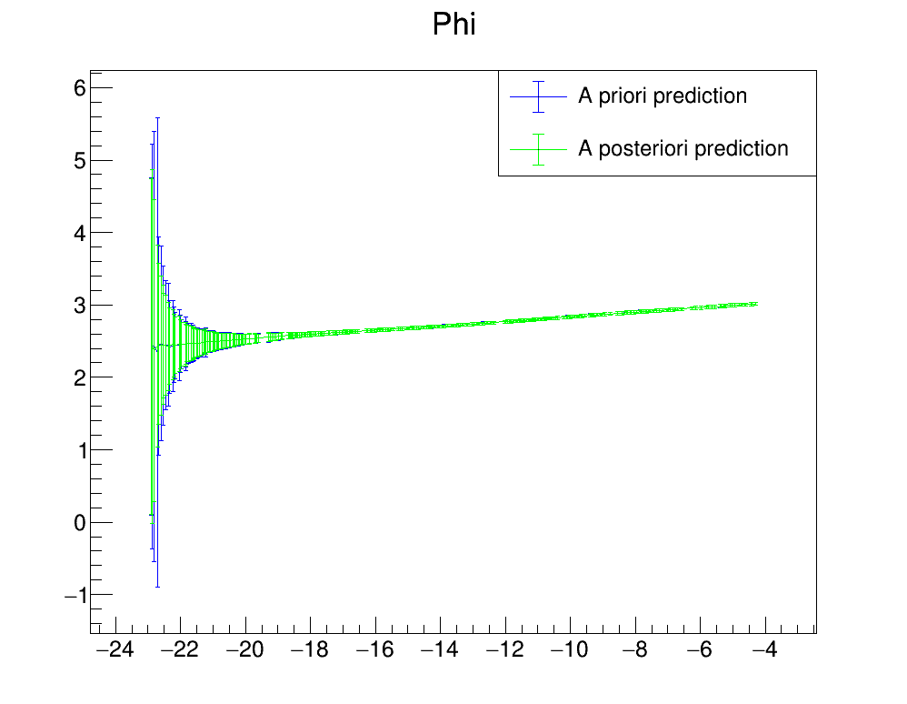
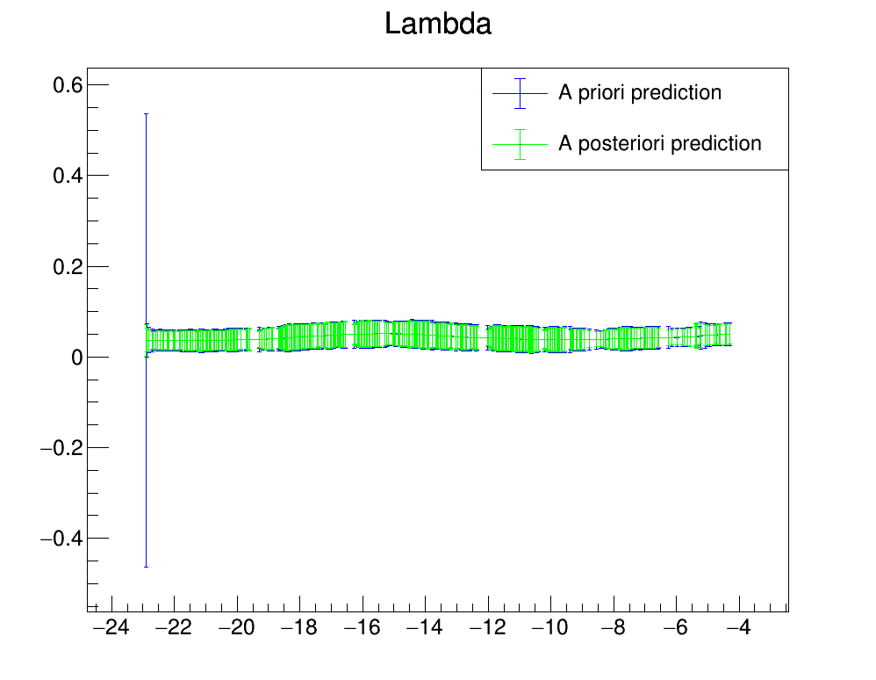
KALMAN FILTER PERFORMANCE
Plots describing the evolution of the estimate of the non measured quantities $(\frac{1}{r},φ,λ)$ as a function of the free parameter $x$

